Slide 1
Applications of Information & Communication Technology
Mr. Ali Haider
Institute Of Management Sciences

Slide 2
Web Development Basics
Understanding what web development is.
Overview of front-end vs. back-end development.
Introduction to web technologies and tools.

Slide 3
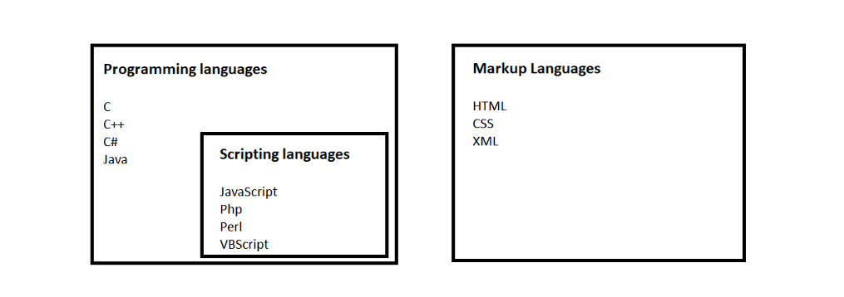
Task
Study about web development in detail.
https://en.wikipedia.org/wiki/Web_development

Slide 4
Setting Up a Development Environment
Choosing the right code editor (e.g., VS Code, Sublime Text).
Installing necessary tools (browsers, version control with Git).
Creating a local server for testing (e.g., using Live Server).

Slide 5
HTML Fundamentals
Introduction to HTML and its role in web development.
Understanding elements, tags, and attributes.
Learning about the structure of an HTML document.

Slide 6
Creating Your First Web Page
Step-by-step guide to building a simple web page.
Adding text, links, and images.
Saving and opening your HTML files in a web browser.

Slide 7
HTML Structure
Understanding the basic structure of an HTML document.
The importance of the <!DOCTYPE> declaration, <html>, <head>, and <body> tags.
Organizing content using sections.

Slide 8
Headings, Paragraphs, and Basic Text Formatting
Using headings (<h1> to <h6>) effectively for content hierarchy.
Creating paragraphs with the <p> tag.
Basic text formatting (bold, italic, underline) using tags like <strong>, <em>, and <u>.
Line Break <br>

Slide 9
Learning Outcomes
Set up a development environment tailored to your needs.
Create a simple web page using HTML.
Understand and apply basic HTML structure and formatting.

Slide 10
Thank You.
The End

